Slide 1
MULTIMEDIA
CATALOG

Slide 2
PC ACCESSORIES

Slide 3
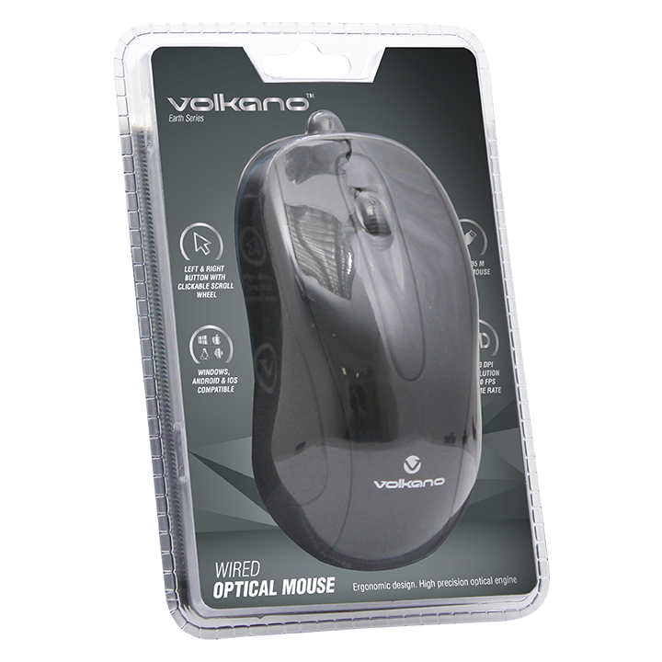
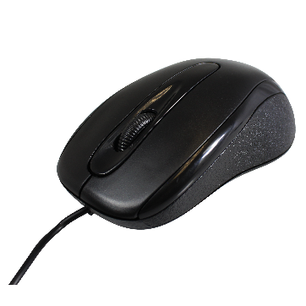
WIRED OPTICAL MOUSE
EARTH SERIES
PRODUCT CODE:
• VB-VS603A
SPECIFICATIONS:
• Speed: 100 cm/s
• Resolution: 1200 dpi
• Connection: USB
SYSTEM REQUIREMENTS:
• Intel / AMD or compatible PC or laptop.
• Microsoft Windows.
• Mac 9.2, OS X or newer.
• USB connector.
FEATURES AND BENEFITS:
• Wired USB Mouse
• 3 Button with Scroll Wheel
• Plug and Play
RSP: R 59.95
PC ACCESSORIES

Slide 4
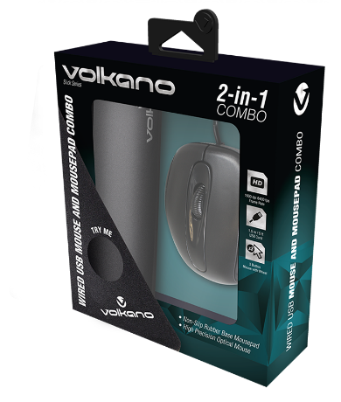
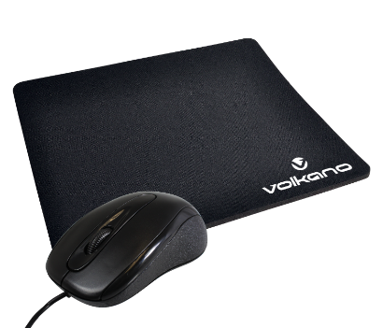
MOUSE AND MOUSEPAD COMBO
SLICK SERIES
PRODUCT CODE:
VK-30025-BK
SPECIFICATIONS:
Sampling Rate: 6400
Resolution: 1600 DPI
Cable: 1.5 m / 5 ft
FEATURES AND BENEFITS:
Non-slip Rubber Base Mousepad
High Precision Optical Mouse
1600 DPI, 6400 fps
1.5 m / 5 ft USB Cord
3 Button Mouse with Scroll Wheel
PACKAGING CONTENTS:
Volkano Slick Series Mousepad
Volkano Slick Series Wired Mouse
RSP: R 99.95
PC ACCESSORIES

Slide 5
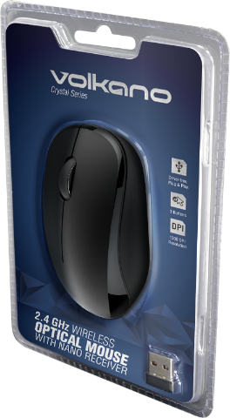
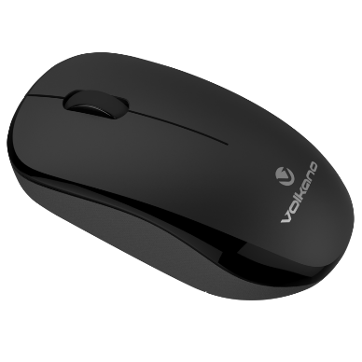
WIRELESS OPTICAL MOUSE
CRYSTAL SERIES
PRODUCT CODE:
VK-20126-BK
SPECIFICATIONS:
Operating Distance: 10 m / 33 feet
Wireless Frequency: 2.4 GHz
Resolution: 1200 DPI
Interface: USB Receiver
Compatibility: Windows, Mac OS, Linux and Android.
Battery: 1 x AA (not included)
FEATURES AND BENEFITS:
Plug & Play
Up to 2400 fps
3 Buttons with Scroll Wheel
USB Nano Receiver
CONTENTS:
Volkano Crystal Mouse
Volkano Crystal USB Receiver
RSP: R 99.95
PC ACCESSORIES

Slide 6
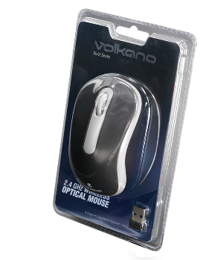
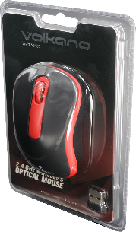
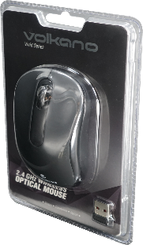
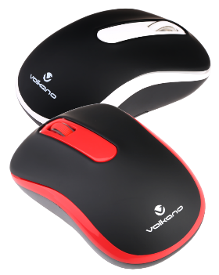
WIRELESS OPTICAL MOUSE
VECTOR VIVID SERIES
PRODUCT CODE:
VK-20034-BK (EOL)
VK-20034-BK-G
VK-20034-RD (EOL) (R 99.95)
VK-20034-RD-G
VK-20034-WT - (R 99.95)
VK-20034-WT-G
SPECIFICATIONS:
Operating Distance: 10 m / 33 feet
Wireless Frequency: 2.4 GHz
Interface: USB Receiver
Compatibility: Windows, Mac OS, Linux and Android.
Battery: 1 x AA (not included)
FEATURES AND BENEFITS:
Plug & Play
2.4 GHz Connectivity
1000 DPI up to 2400 fps
3 Buttons with Scroll Wheel
CONTENTS:
Volkano Vector Vivid Mouse
Volkano Vector Vivid USB Receiver
PC ACCESSORIES

Slide 7
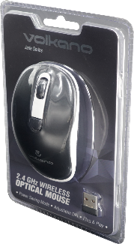
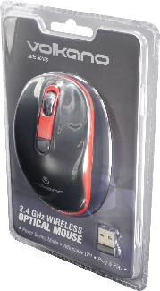
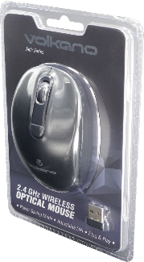
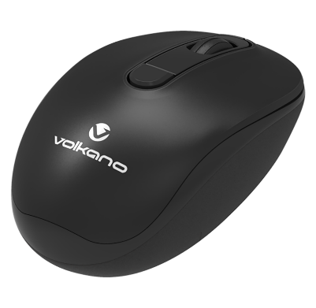
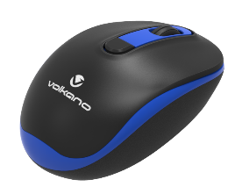
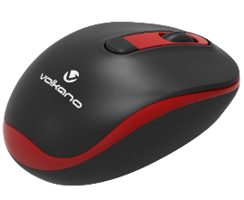
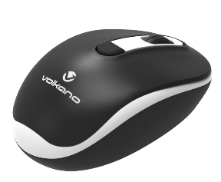
WIRELESS OPTICAL MOUSE
JADE SERIES
PRODUCT CODE:
Black: VK-20125-BK
Black and Blue: VK-20125-BKBL
Black and Red: VK-20125-BKRD
Black and White: VK-20125-BKWT
SPECIFICATIONS:
Operating Distance: 10 m / 33 feet
Wireless Frequency: 2.4 GHz
Interface: USB Receiver
Adjustable DPI: 1000 / 1200 / 1600
Compatibility: Windows, Mac OS, Linux and Android
Battery: 1 x AA (not included)
FEATURES AND BENEFITS:
Plug and Play
High Precision Optical Engine
3 DPI Modes 1000 / 1200 / 1600
Power Saving Mode
4 Buttons Plus Scroll Wheel
CONTENTS:
Volkano Jade Series Wireless Mouse
Volkano Jade Series USB Receiver
PC ACCESSORIES

Slide 8
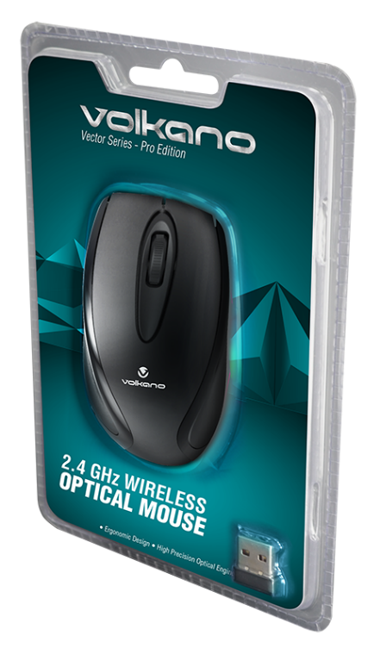
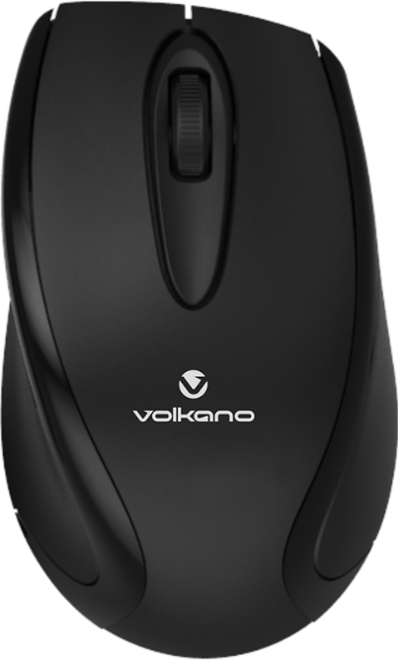
LARGE WIRELESS OPTICAL MOUSE
VECTOR PRO SERIES
PRODUCT CODE:
VB-VS604-BLK
SPECIFICATIONS:
Operating Distance: 10 m / 33 feet
Wireless Frequency: 2.4 GHz
Interface: USB Receiver
Resolution DPI: 1200
Compatibility: Windows, Mac OS, Linux and Android
Battery: 2 x AAA (not included)
FEATURES AND BENEFITS:
Driver Free Plug & Play
2.4GHz Connectivity
Scroll Wheel with Button
CONTENTS:
Volkano Vector Pro Wireless Mouse
Volkano Vector Pro Wireless Mouse Dongle
RSP: R 149.95
PC ACCESSORIES

Slide 9
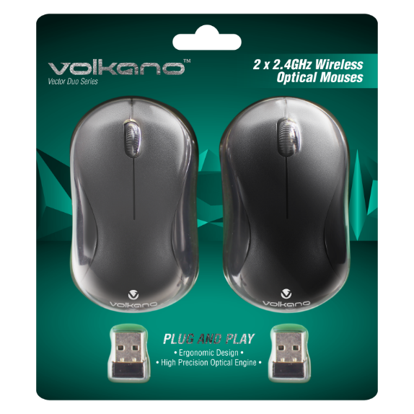
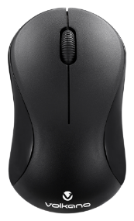
WIRELESS OPTICAL MOUSE DUAL PACK
VECTOR DUO SERIES
PRODUCT CODE:
VK-20076-BK
SPECIFICATIONS:
Operating Distance: 10 m / 33 feet
Wireless Frequency: 2.4 GHz
Interface: USB Receiver
DPI: 1000
Compatibility: Windows, Mac OS, Linux and Android
Dimensions: 120 x 67 x 40 mm / 4.72 x 2.64 x 1.57 in
Product Weight: 0.07 kg / 2.47 oz
Batteries: 1 x AA (not included)
FEATURES AND BENEFITS:
2.4 GHz wireless
Storage for Nano USB Receiver
Battery Compartment
Left and Right Mouse Buttons
Scroll Wheel with Button
CONTENTS:
2 x Vector Duo Wireless Mouses
2 x Vector Duo Nano USB receivers
RSP: R 229.95
PC ACCESSORIES

Slide 10
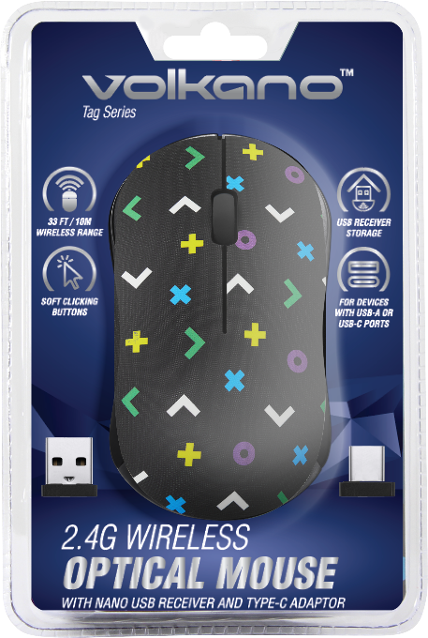
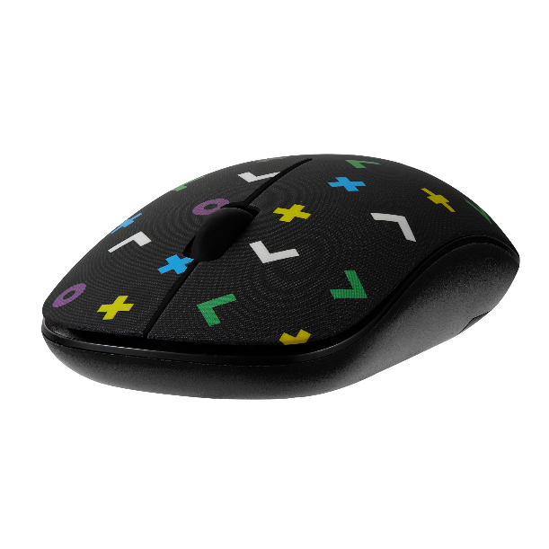
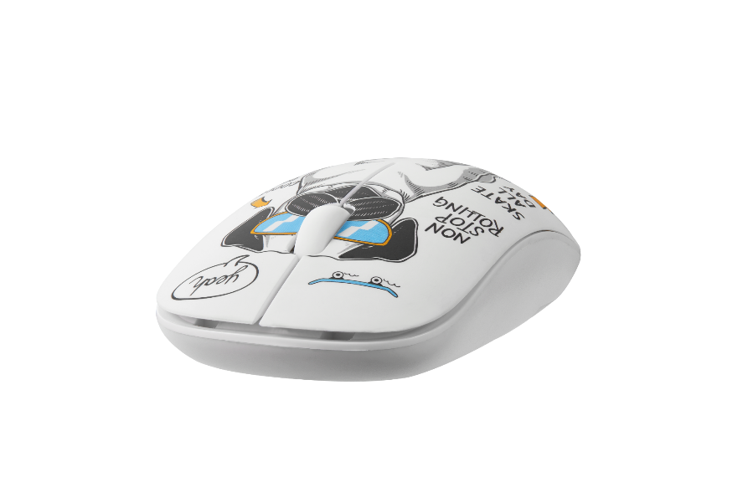
WIRELESS OPTICAL MOUSE
TAG SERIES
PRODUCT CODE:
VK-20180SA-GEO
VK-20180SA-PUG
SPECIFICATIONS:
Battery Type: x1 AA battery (not included)
Resolution: 1200 dpi
Operation: Left / Right Button with Scroll Wheel
Wireless: 2.4G
Operation Distance: 10 m / 33 ft
Connection: USB Receiver
114 x 61 x 33 mm / 4.48 x 2.4 x 1.32 inch
FEATURES AND BENEFITS:
2.4 GHz wireless
Storage for Nano USB Receiver
Battery Compartment
Left and Right Mouse Buttons
Scroll Wheel with Button
CONTENTS:
1 x Tag Series Wireless Mouses
1 x Nano USB receivers
Type-C Adapter
PC ACCESSORIES

Slide 11
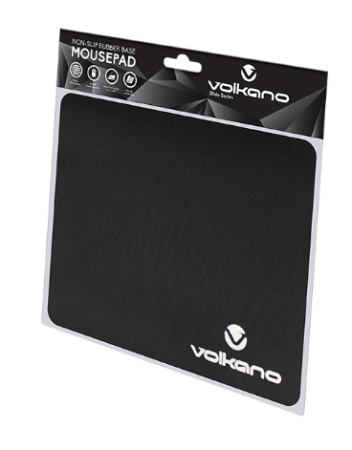
MOUSE PAD
SLIDE SERIES
PRODUCT CODE:
VK-20007-BK
SPECIFICATIONS:
Size: 220 x 180 x 3 mm
FEATURES AND BENEFITS:
Porous Fabric Surface
Smooth Mouse Operation
Cleans your Mouse as You Use It
Non-slip Rubber Base
RSP: R 39.95
PC ACCESSORIES

Slide 12
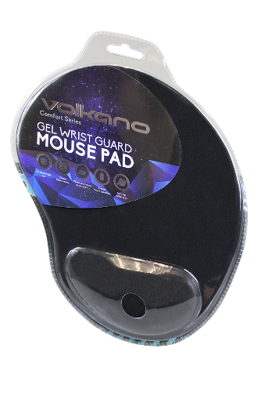
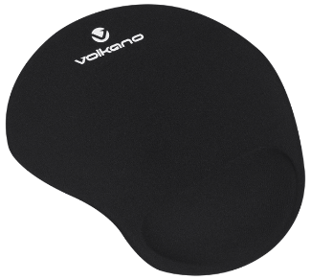
GEL WRIST GUARD MOUSE PAD
COMFORT SERIES
PRODUCT CODE:
VK-20009-BK
FEATURES AND BENEFITS:
Gel Wrist Guard for Comfortable Use
Porous Fabric Surface
Cleans Your Mouse as you Use It
Smooth Gliding Surface
Non-slip Rubber Base
RSP: R 129.95
PC ACCESSORIES

Slide 13
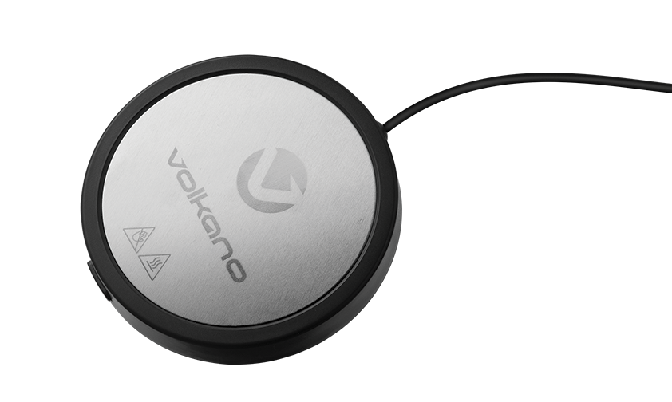
10W USB CUP WARMER
ROAST SERIES
PRODUCT CODE:
VK-5123-BK
SPECIFICATIONS:
Power Input: USB - DC 5.0 V
Current: 2000 mA
Consumption: 10 W
Material: ABS + Aluminium
Size: (D) 100 x (H) 16 mm
Max Temperature: 90 °C
PACKAGE CONTENT:
Volkano Roast series 10W USB Cup Warmer
Instruction manual
RSP: R
PC ACCESSORIES

Slide 14
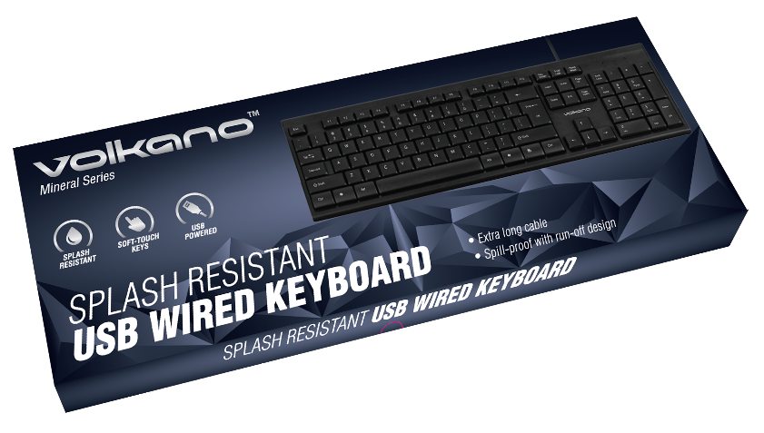
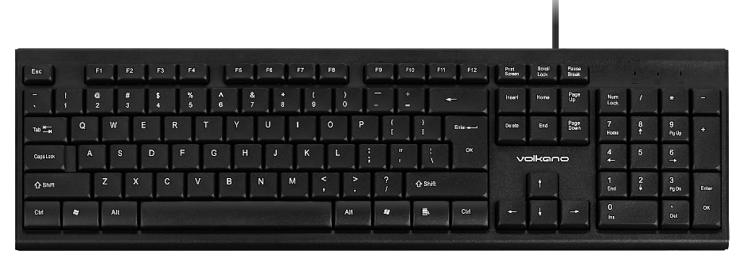
USB WIRED KEYBOARD
MINERAL SERIES
PRODUCT CODE:
VB-VS040-BK[V2]
SPECIFICATIONS:
Cable Length: 1.3 m
Key Pitch: 19 mm
USB Protocol: USB 2.0, compatibility with USB 1.0 and USB 3.0
Current: 50 mA
Dimensions: 438.5 x 135.8 x 16.6 mm
FEATURES AND BENEFITS:
Plug & Play
Spill Proof Keyboard with Run-Off Design.
Soft-Touch Keys
USB Powered with Extra-long Cable
CONTENTS:
Volkano Mineral Series Keyboard
RSP: R 149.95
PC ACCESSORIES

Slide 15
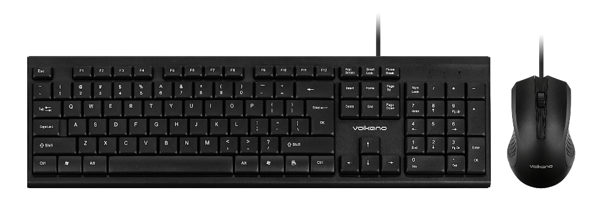
WIRED USB KEYBOARD & MOUSE COMBO
MINERAL SERIES
PRODUCT CODE:
VB-VS041-BK[V2]
SPECIFICATIONS:
Mouse
Cable Length: 1.5 m
Resolution: 1000 DPI
Working Voltage: 5 V DC ± 5%
Operating Current: 37 mA (max)
Dimensions: 103 x 64 x 38 mm
Keyboard
Cable Length: 1.3 m
USB Protocol: USB 2.0
Working Voltage: 4.5 V to 5.5 V
Dimensions: 438.5 x 135.8 x 16.6 mm
FEATURES AND BENEFITS:
Splash and Spill Resistant Keyboard
Soft-Touch Keys
USB Powered with Extra-long Cable
Ergonomic High Resolution Mouse
CONTENTS:
Volkano Mineral Series Wired Mouse
Volkano Mineral Series Wired Keyboard
RSP: R 199.95
PC ACCESSORIES

Slide 16
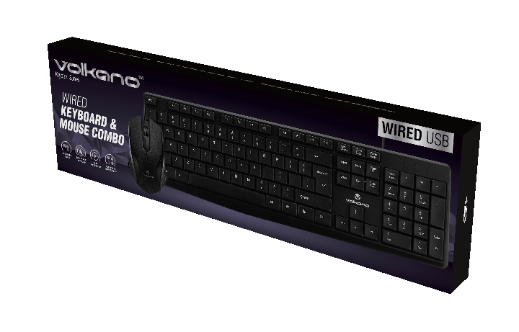
WIRED USB KEYBOARD & MOUSE COMBO
KRYPTON SERIES
PRODUCT CODE:
VK-20122-BK
SPECIFICATIONS:
Pack Weight: 1.1 lbs / 0.5 kg
Pack Dimensions: 6.3" x 20.35" x 1.57" /
160 mm x 517 mm x 40 mm
Keyboard:
Key Type: Standard US Layout
Key System: Membrane
Cable Length: 4 ft / 1.4 m
Function Keys: 12
Operating Voltage: 4.75 ~ 5.25 V DC
Connection Method: USB
Mouse:
Buttons: 3
Sensor Type: Optical
DPI: 1000
Scroll Wheel: Yes
Compatibility: Windows, MacOS, Linux, Android 4.4 up
FEATURES AND BENEFITS:
Ergonomically designed for comfortable use
Spill proof keyboard
Plug and Play easy installation
Compatible with Windows, Mac, Linux and Android
CONTENTS:
Volkano Krypton Series Wired Mouse
Volkano Krypton Series Wired Keyboard
RSP: R 199.95
PC ACCESSORIES

Slide 17
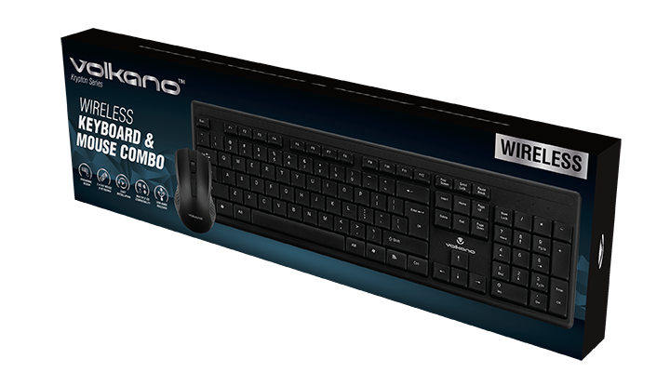
WIRELESS USB KEYBOARD
& Mouse Combo
KRYPTON SERIES
PRODUCT CODE:
VK-20123-BK
SPECIFICATIONS:
Keyboard:
Key Type: Standard US Layout
Key System: Membrane
Function Keys: 12
Batteries Required: 1 x AA (Excluded)
Operating Voltage: 1.5 V DC
Wireless Range: 8 m / 26 ft
Dimensions: 17.13" x 5.91" x 9.37" /
L 440 mm x W 140 mm x H 25 mm
Mouse:
Buttons: 3
Sensor Type: Optical
DPI: 1000
Scroll Wheel Yes
Wireless Type: 2.4 GHz
Batteries Required: 2 x 1.5 AAA (Excluded)
Wireless Range: 8 m / 26 ft
Dimensions: 4.4" x 2.5" x 1.4" / 113 x 65 x 38 mm
Compatibility: Windows, MacOS, Linux, Android 4.4 up
Pack Dimensions: 6.3" x 20.35" x 1.57" /
160 mm x 517 mm x 40 mm
CONTENTS:
Volkano Krypton Wireless Keyboard
Volkano Krypton Wireless Mouse
Volkano Krypton Nano USB Receiver
RSP: R 299.95
PC ACCESSORIES

Slide 18
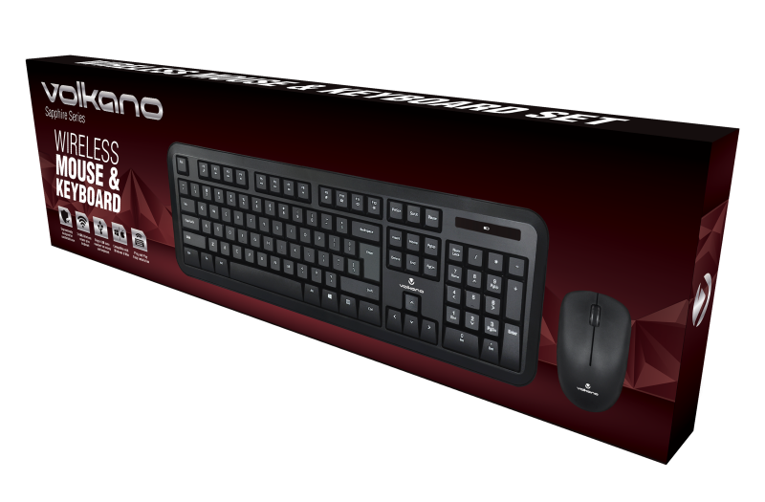
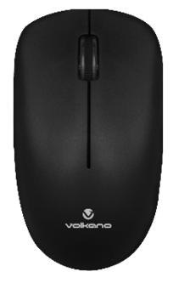
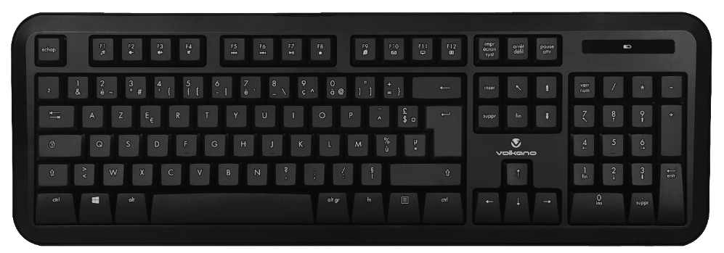
WIRELESS KEYBOARD AND
MOUSE COMBO
SAPPHIRE SERIES
PRODUCT CODE:
VK-20008-BK
SPECIFICATIONS:
Wireless transmission distance: 6 ~ 8 M
Wireless Frequency: 2408 Mhz ~ 2474 Mhz
Nano USB Receiver: Single Receiver for Keyboard and Mouse
Wireless Operation Channels: 34 auto hopping
Keyboard
Keyboard Mechanical life: 5 million times
Keyboard rating working current: 2.5 m,A @ 1.5 V
Keyboard size: 468 x 155.38 x 22.97 mm / 18.42” x 6.11” x 0.90”
Mouse
DPI: 1200
Mouse rating: 10 mA @ 1.5 V
Mouse size: 100 × 59.62 × 39.17 mm / 3.93” × 2.34” × 1.54”
FEATURES AND BENEFITS:
Ergonomically designed for comfortable use
USB Plug and Play Easy installation
Compatible with Windows & Mac
Single USB nano receiver for mouse and keyboard
2.4GHz Wireless mouse plus keyboard
CONTENTS:
Volkano Sapphire Series Wireless Mouse
Volkano Sapphire Series Wireless Keyboard
Nano USB Receiver (inside the battery compartment of the Mouse)
1 x AA Battery
1 x AAA Battery
Instruction Manual
RSP: R 299.95
PC ACCESSORIES

Slide 19
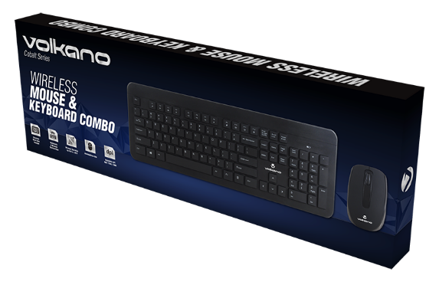
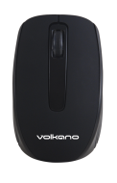
WIRELESS KEYBOARD AND
MOUSE COMBO
COBALT SERIES
PRODUCT CODE:
VK-20120-BK
SPECIFICATIONS:
Wireless Frequency: 2.4 GHz
Range: 10 m / 33 ft
Keyboard
Size: 450 x 158.04 x 23.4 mm
Operating Voltage: 1.5 V DC
Batteries: 1 x AAA (not included)
Mouse
Sensor: Mosart
DPI: 800 / 1200 / 1600
Mouse size: 99.95 x 61.50 x 35.20 mm
Batteries: 1 x AA (not included)
FEATURES AND BENEFITS:
KEYBOARD
Chocolate block style keycaps
Multimedia and Windows shortcut keys
Wireless operation up to 8 meters
Ergonomic Design
MOUSE
Ambidextrous use
Adjustable DPI 800 / 1200 / 1600
Wireless operation up to 8 meters
CONTENTS:
Volkano Cobalt Series Wireless Keyboard
Volkano Cobalt Series Wireless Mouse
Nano USB Receiver
Instruction Manual
RSP: R 399.95
PC ACCESSORIES

Slide 20
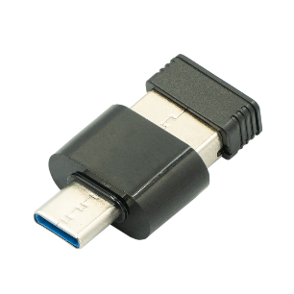
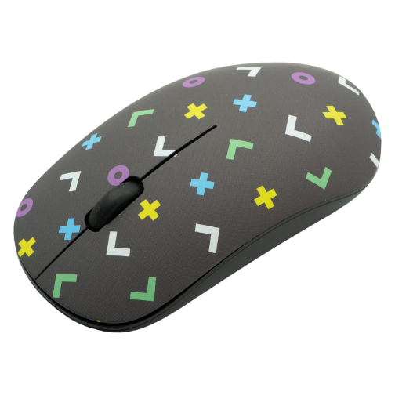
2.4G WIRELESS OPTICAL
MOUSE USB / TYPE-C
TAG SERIES
PRODUCT CODE:
VK-20180SA-GEO
SPECIFICATIONS:
Wireless Type: 2.4GHz
Wireless Range: Up to 10 Meters
Compatibility: Windows, MAC OS, Linux, Android, Chrome OS
Battery Required: 1 x AA (Alkaline recommended)
FEATURES AND BENEFITS:
Wireless up to 10 M
1200 DPI High Resolution
USB Receiver Storage Inside Mouse
Plug and Play
Soft Click Buttons
USB and Type-C Receiver
CONTENTS:
Volkano Tag Wireless Mouse
USB plus Type-C Receiver
PC ACCESSORIES

Slide 21
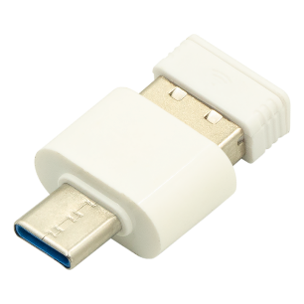
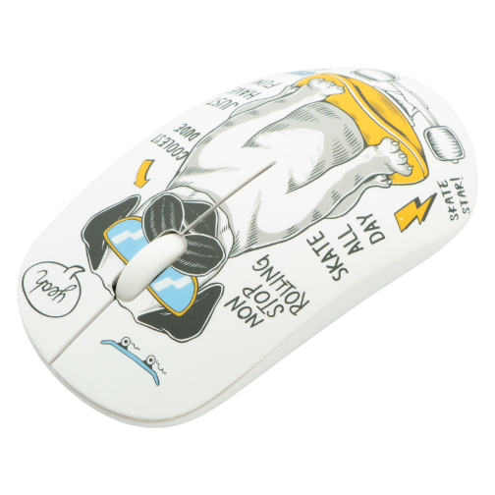
2.4G WIRELESS OPTICAL
MOUSE USB / TYPE-C
TAG SERIES
PRODUCT CODE:
VK-20180SA-PUG
SPECIFICATIONS:
Wireless Type: 2.4GHz
Wireless Range: Up to 10 Meters
Compatibility: Windows, MAC OS, Linux, Android, Chrome OS
Battery Required: 1 x AA (Alkaline recommended)
FEATURES AND BENEFITS:
Wireless up to 10 M
1200 DPI High Resolution
USB Receiver Storage Inside Mouse
Plug and Play
Soft Click Buttons
USB and Type-C Receiver
CONTENTS:
Volkano Tag Wireless Mouse
USB plus Type-C Receiver
RSP: R 199.99
PC ACCESSORIES

Slide 22
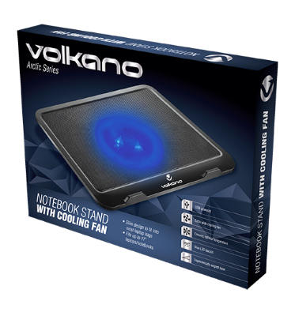
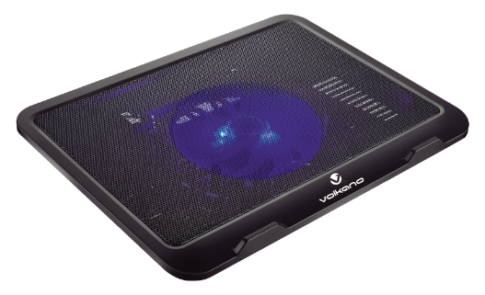
NOTEBOOK COOLING STAND
ARCTIC SERIES
PRODUCT CODE:
VK-20013-BK
SPECIFICATIONS:
Product Size: 330 x 20 x 42 mm
Fan Size: 125 x 125 x 15 mm
Fan Speed: 1000 RPM
Material: ABS/ Steel
USB Power: 1,8 W
Current: 0,38 A
FEATURES AND BENEFITS:
USB Powered
Extra Wide Cooling Fan
Ensures Optimal Temperature
Blue LED Backlit
Ergonomically Angled Base
Slim Design – Fits into most Laptop Bags
Fits up to 17” Laptops / Notebooks
CONTENTS:
Volkano Arctic Series Notebook Cooling Stand
RSP: R149.95
PC ACCESSORIES

Slide 23
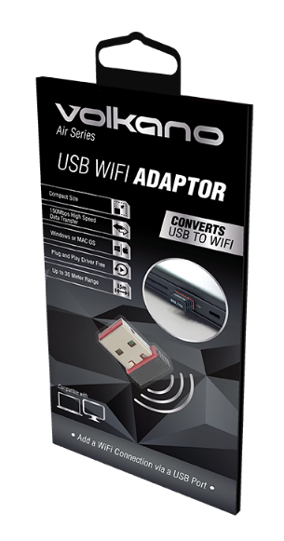
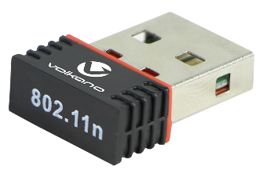
USB WIFI ADAPTOR
AIR SERIES
PRODUCT CODE:
VK-20073-BK
SPECIFICATIONS:
Supported Speed: Up to 150 Mbps
Optimal Range: Up to 35 m
Supported Protocols: 802.11n / 802.11g
OS Compatibility: Windows 10, Mac OS 10.6 up, Linux
FEATURES AND BENEFITS:
Converts USB to WiFi
Compact Size
150 Mbps High Speed Data Transfer
Windows or MAC OS
Plug and Play Driver Free
Up to 35 m Range
PACKAGING CONTENTS:
Volkano Air series USB WiFi adaptor
RSP: R 129.95
PC ACCESSORIES

Slide 24
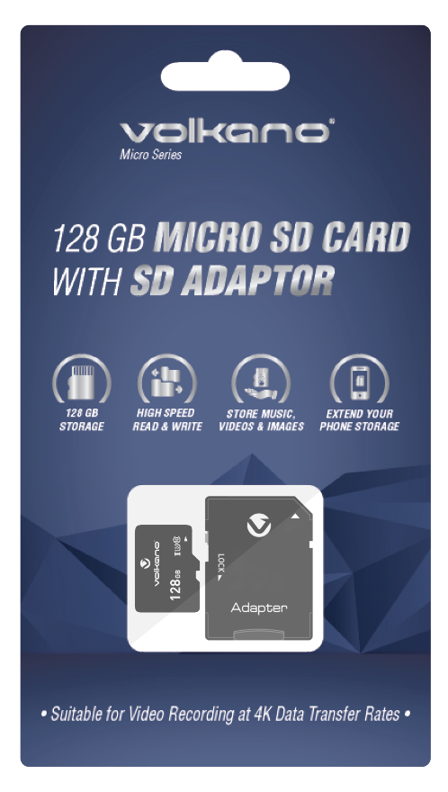
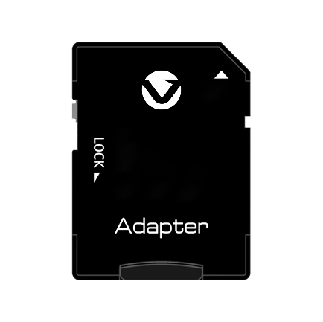
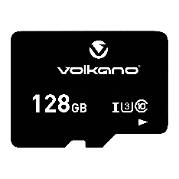
MICRO SD CARD WITH SD ADAPTOR
MICRO SERIES
PRODUCT CODE:
VK-20222-BK
Compatibility:
• HD Camera
• 4K Drone
• Smart Mobile Phone
• Player
• High-end Smart Devices etc.
• Class 10, UHS 3
Features:
• Class 10, UHS 3
• 3.0 High Speed
• R / W : 80 mb / 30 ~ 45 m
Whats In The Pack:
• Volkano Micro SD Card
• Volkano SD Card Adaptor
RSP: R 0.00
PHONE ACCESSORIES

Slide 25
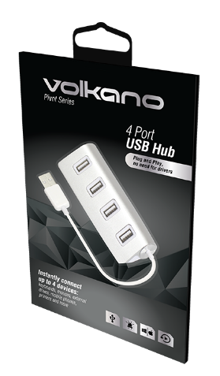
4 PORT USB HUB
PIVOT SERIES
PRODUCT CODE:
VK-20011-SL
SPECIFICATIONS:
Transfer Speed: Up to 480 Mbps
Compatibility: Windows & Mac OS
USB version: USB 2.0
Connection: Plug & Play
Power supply: 5 V, 1 A
Current protection: Individual Port
FEATURES AND BENEFITS:
Plug & Play
USB Powered
Compatible with Windows & Mac
Blue LED Light Indicator
Tough Aluminium Body
RSP: R 129.95
PC ACCESSORIES

Slide 26
2.5” EXTERNAL HARD DRIVE CHASSIS
DOSSIER SERIES
PRODUCT CODE:
VK-20049-BK
SPECIFICATIONS:
Maximum HDD Size: 2.5" x 9.5 mm thick
Maximum Data Size: HDD = 2TB / SSD = 1TB
Data Transfer Mode: USB 3.0 high speed
SATA version: SATA III, II or I
Construction: Aluminium
Weight: 54 g
FEATURES AND BENEFITS:
Removable Aluminium Housing
SATA 3 Connector
High Speed USB 3.0
CONTENTS:
Volkano Dossier Hard Drive / SSD External Chassis
USB 3.0 Data/Power Cable
Set of mounting screws
Screwdriver
Carry Pouch
RSP: R 229.95
PC ACCESSORIES

Slide 27
USB 3.0 HIGH SPEED
MULTI CARD READER
READER SERIES
PRODUCT CODE:
VK-20012-BK
SPECIFICATIONS:
Supported Card Types: SD, SDHC, SDXC,
Micro SD and CF (Compact Flash)
Supported Card Capacity: Up to 256 GB
USB Version: USB 3.0
Compatibility: USB 2.0 & USB 1.1
Transfer Speed: 5.0 Gbps
FEATURES AND BENEFITS:
Plug & Play
USB 3.0 Powered
LED Light Indicator
Memory Card Storage Compartment
Reads & Writes Multiple Card Formats
PACKAGING CONTENTS:
Volkano Reader series USB 3.0 Card Reader
PC ACCESSORIES

Slide 28
UPRIGHT NOTEBOOK COOLING STAND
GLACIER SERIES
PRODUCT CODE:
VK-20053-BK[V2]
SPECIFICATIONS:
Input: 5 V @ 500 mA
Product Size: 390 x 280 x 28 mm
Consumption: 2 W max
Fan Speed: 1 200 rpm ± 1-%
Air Flow: 115 CFM
Noise Level: 21 - 26.5 dBA
FEATURES AND BENEFITS:
Lie flat or incline in steps up to 21.6°
USB Powered
Dual 125 mm Fans
Ensures Optimal Temperature
Blue LED Backlighting
Fits up to 17″ Laptops
CONTENT:
Volkano Glacier adjustable notebook cooling stand
USB power cable for fans
PC ACCESSORIES

Slide 29
HIGH QUALITY 720P USB WEBCAM
ZOOM 700 SERIES
PRODUCT CODE:
VK-10103-BK
SPECIFICATIONS:
Sensor: 2 MP CMOS（F23)
Sensor Size: 1/4"
Output Image and Video: Format: H.264 / M-JPEG
Resolution: 1920 x 1080 @ 30 fps
View Angle: 90°
Dynamic Range: 72 dB
Interface Type: USB 2.0 High Speed
(UVC & UVA) Plug and Play
AEC (Absolute Exposure Control): AUTO
AEB: AUTO
AGC (Automatic Gain Control): AUTO
Microphones: Dual Mics
Working Voltage: DC 5 V
Working Current: ≤120 mA
Compatibility: Windows, Mac OS, Linux, and Android
FEATURES AND BENEFITS:
High Sensitivity Noise Reduction Microphone
HD High Sensitivity MIC
90˚ Adjustable Lens
USB Plug & Play
Perfect for Video Streaming or Conferencing
CONTENTS:
Volkano - Zoom Series 720p USB Webcam
Instruction Manual
CAMERAS & ACCESSORIES

Slide 30
HIGH QUALITY 720P USB WEBCAM
ZOOM 720 SERIES
PRODUCT CODE:
VK-10101-BK
SPECIFICATIONS:
Sensor: 2 MP CMOS（F23)
Sensor Size: 1/4"
Output Image and Video Format: H.264 / M-JPEG
Resolution: 1920 x 1080 @ 30 fps
View Angle: 90°
Dynamic Range: 72 dB
Interface Type: USB 2.0 High Speed
(UVC & UVA) Plug and Play
AEC (Absolute Exposure Control): AUTO
AEB: AUTO
AGC (Automatic Gain Control): AUTO
Microphone: Dual Mics
Working Voltage: DC 5 V
Working Current: ≤120 mA
Compatibility: Windows, Mac OS, Linux and Android
FEATURES AND BENEFITS:
High Sensitivity Noise Reduction
HD High Sensitivity MIC
90˚ Adjustable Lens
USB Plug & Play
Perfect for Video Streaming or Conferencing
CONTENTS:
Volkano Zoom Series 720p USB Webcam
Instruction Manual
CAMERAS & ACCESSORIES

Slide 31
FULL HD 1080P USB WEBCAM
ZOOM 1080 SERIES V2
PRODUCT CODE:
VK-10102-BK[V2]
SPECIFICATIONS:
Sensor: 2 MP OV3660
Sensor Size: 1/5"
Output Image and Video Format: M JPEG / YUY
Resolution: 1600 x 1080 @ 30 fps
View Angle: 110°
Dynamic Range: 72 dB
Interface Type: USB 2.0 High Speed (UVC）
AEC (Absolute Exposure Control): AUTO
AEB: AUTO
AGC (Automatic Gain Control): AUTO
MIC: Built-in high sensitivity noise reduction microphone
Working Voltage: DC 5 V
Working Current: ≤120 mA
Compatibility: Windows, Mac OS, Linux and Android
FEATURES AND BENEFITS:
Noise Reduction
HD High Sensitivity MIC
110˚ Adjustable Lens
USB Plug & Play
Perfect for Video Streaming Conferencing or Streaming
CONTENTS:
Volkano Zoom Series 1080P Webcam
Flexible Monitor Mount
CAMERAS & ACCESSORIES

Slide 33
DASH CAMERA & REVERSE CAMERA
FEATURES & BENEFITS
LCD Display: 4.5 inch HD screen
Video Resolution: Front Facing 1920P x 1080P Full HD
Chip Set (CPU): XNM-550
Dual Cameras
Camera display: Picture in picture
Excellent Night vision
Lens : 7 layers glass lens
170 Degrees, Front Wide Lens, capture over 4 lanes
140 Degrees Rear Reverse Wide Lens Camera
Picture: JPEG (264 image compression technique)
Camera Resolution: 2M
Protect Level/ G sensor - Date & Time Stamp - Cycle/ Loop recording
Automatic recording when the vehicle starts, switches off when vehicle switches off
Supports Micro SD Cards up to 32GB
Both Cameras show on LCD with 6 modes, press the up button to switch display mode
HDR, Parking Monitoring, Motion detection, Rear lens cable for connecting to reverse light
RSP: R 699.95

Slide 34
UNIVERSAL LAPTOP CHARGER
OMNI SERIES
PRODUCT CODE:
VK-8023-BK
SPECIFICATIONS:
Total Power Output: 90 Watt
Connection Type: 8 Assorted Tips
Output Power: 12 V DC ~ 20 V DC
LED Indicator Yes
Input Voltage: 100 ~ 240 V AC
Tips: M4, M5, M9, M12, M15, M18, M28, M29
FEATURES AND BENEFITS:
Output Voltage: 12 V DC ~ 20 V DC.
8 Tips to Fit Most Popular Laptop Models
Auto Voltage Selection
High Power - 90 Watt
Includes New 12 V Tip for Slimline Intel Celeron and i3 Models and AMD Models
Overload & Overvoltage Protection
CONTENTS:
Volkano Universal Laptop Charger
AC Power Cable
8 Assorted Tips
Instruction Manual
Includes New 12 V Tip for Slimline Intel Celeron and i3 Models and AMD Models
PC ACCESSORIES

Slide 35
UNIVERSAL LAPTOP CHARGER
OMNI PLUS SERIES
PRODUCT CODE:
VK-8047-BK
FEATURES AND BENEFITS:
This laptop power adaptor will charge and power all popular Celeron and AMD A4 laptops from HP, Dell, Acer, Lenovo, Asus and others
Includes new 12 Volt tip for Slimline Intel Celeron and AMD A4 Models from Connex, Ilife and Mecer
70 Watt high power output
Power Indicator Light
SPECIFICATIONS:
AC Input: 100 ~ 240 V AC
DC Output: 12 ~ 20 V DC
Maximum Power: 70 Watt
Connection Type: 8 Assorted DC Tips
CONTENTS:
Volkano Omni Plus Universal Laptop Charger
AC Power Cable
8 Assorted Tips
Instruction Manual
Includes New 12 V Tip for Slimline Intel Celeron and i3 Models and AMD Models
RSP: R 599.00
PC ACCESSORIES

Slide 36
MINI NETWORK / CCTV UPS
CONSTANT SERIES
PRODUCT CODE:
VK-9100-WT
SPECIFICATIONS:
• Battery Power: 8800 mAh Li-Ion
• Input Power: 220 ~ 240 V AC
• Outputs: 9 V / 12 V Switchable DC
15 V / 24 V Switchable DC; USB 5 V DC
• Total Power: 17 Watts - P.O.E.
Multi-voltage up to 24 V
FEATURES AND BENEFITS:
Suitable for wired and wireless networks
Suitable for CCTV
Dual DC Output for 2 devices
USB Port for Third Device
LED Power Indicator and Power Over Ethernet
CONTENTS:
Volkano Constant Series Mini Network UPS
1 x 20 cm Dual DC Power Cable
1 x 1.8 meter DC Power Cable
1 x 2 meter DC Male to Female Extension Cable
Figure 8 Mains Cable
Instruction Manual
PC ACCESSORIES

Slide 37
MULTIMEDIA

Slide 38
0.75M TYPE-C TO TYPE-C CABLE
CONNECT C SERIES
PRODUCT CODE:
VK-20200-BK
SPECIFICATIONS:
Connectors:Gold Plated
• Cable Length: 0.75 m / 2.5 ft
• Data Transfer: USB 3.1 up to 10 Gbps
• Charge Rate: Up to 3 A @ 20 Volt (60 Watt)
FEATURES AND BENEFITS:
Connect USB Devices with Type-C Connector
High Speed Data Transfer
High Speed Charging
Male to Male Connectors
Copper Conductor
RSP: R 59.95 / R79.95
CABLES & ADAPTORS

Slide 39
IN-LINE BOOM
MICROPHONE
CHAT BOOM SERIES
PRODUCT CODE:
VK-6509-BK
SPECIFICATIONS:
Toggle Switch: Mute Button
Signal to Noise Ratio: >58 dB
Frequency Response: 100 Hz - 20 kHz
Mic Sensitivity: -40 dB ±3 dB
Mic Impedance: 16Ω
Mic Direction: Omnidirectional
Max. Sound Pressure Level: 110 dB
Mic Type: Eletret Condenser
Headphone Volume Control: Yes
Headphone Output Jack: 3.5 mm 4 pole
FEATURES AND BENEFITS:
AUX Connector
Inline Volume Control
Mute Switch
Adjustable Boom Arm
Use With Any Headset With An AUX Socket
PACKAGING CONTENTS:
Volkano Chat Boom AUX Microphone
Instruction Manual
RSP: R 129.95
MULTIMEDIA

Slide 40
3.5MM TIE-CLIP MICROPHONE
CLIP SERIES
PRODUCT CODE:
VK-6507-BK
HEADPHONE SPECIFICATIONS:
Signal to Noise Ratio: >60 dB
Frequency Response: 50 Hz - 16 KHz
Mic Sensitivity: -34 dB +/-3 dB
Mic Impedance: 2.2 kΩ
Mic Direction: Omnidirectional
Mic Type: Electret Capacitance
FEATURES AND BENEFITS:
For streaming with computers or mobile phones
Computer or Mobile Phone Streaming
3.5 mm Jack
Tie Clip Included
Noise Filter Included
Clip to Clothing
PACKAGING CONTENTS:
Clip Series Tie Clip Microphone
Foam Noise Filter
Mobile Phone Adaptor Cable
Instruction Manual
RSP: R 149.95
HOME OFFICE

Slide 41
MINI DISPLAYPORT TO
VGA ADAPTOR
MINIPORT SERIES
PRODUCT CODE:
VK-20195-WT
SPECIFICATIONS:
• Input: Mini Display port
• Output: VGA Socket
• Resolution: Up to 1080 P @ 60 Hz
• Cable Length: 10 cm
FEATURES AND BENEFITS:
• Plug & Play
• VGA full HD Video Output
• Compatible with most Graphic Cards
• Compatible with Apple Thunderbolt
RSP: R 199.95
CABLES & ADAPTORS

Slide 42
SMART TV REMOTE CONTROL WITH
KEYBOARD & TOUCHPAD
CONTROL SERIES
PRODUCT CODE:
VK-20038-BK
SPECIFICATIONS:
Battery: 300 mAh Lithium Polymer
Charge System: USB 5 V DC, 300 mA
Transmission System: RF 2.4 Ghz
Transmission Range: 10 m / 33 ft / 0.39"
Product Size: 147 x 97 x 19 mm
Weight: 110 g
Compatibility: Windows, Mac OS, Linux, Android
FEATURES AND BENEFITS:
Rechargeable Battery
QWERTY Keyboard
Touchpad with Multi Touch Input
Plug & Play
CONTENTS:
Volkano Control Series Remote
Instruction Manual
USB Receiver
300 mAh Lithium Polymer Battery
Micro USB Charging Cable
RSP: R 249.95
MULTIMEDIA

Slide 43
HDMI TO VGA ADAPTOR
WITH AUDIO
ANNEX SERIES
PRODUCT CODE:
VK-20045-BK
SPECIFICATIONS:
Input Signal: HDMI digital video and audio
Video Out: VGA analogue
Audio Out: 3.5mm Aux
Resolutions: 480i / 480p / 800 x 600 / 720i / 720p / 1280 x 1024 /
1600 x 1200 / 1080i / 1080p
Bandwidth: 165 MHz / 1.65 Gbps per channel
(6.75 Gbps all channels)
Frequency: 50 - 60 Hz
FEATURES AND BENEFITS:
Full HD Support
Converts Audio & Video
Plug & Play
Micro USB Power Port
CABLES & ADAPTORS

Slide 44
WIRELESS PRESENTER
with Laser Pointer
PRESENT SERIES
PRODUCT CODE:
VK-20010-BK
SPECIFICATIONS:
Transmitter
Frequency: 2.4 GHz
Max Output: < 5 mW
Battery: 1 x AAA (Not Included)
Dimensions: 138 x 18 x 15 mm
Weight: 20 g
Receiver
Operation System: Windows XP, 7, 8, 10, Mac OS,
Linux, Android 4.4 and Later
Working Voltage: 5 V DC
Weight: 2.1 g
FEATURES AND BENEFITS:
Forward / Backward Key Control
2.4 GHz Wireless Presenter Remote Control
USB Nano Receiver
Multi OS Compatible
Plug & Play
CONTENTS:
1 x Volkano Present Series Wireless Laser Pointer
1 x Wireless Receiver
1 x User Manual
1 x Carry Pouch
MULTIMEDIA

Slide 45
DISPLAYPORT TO HDMI ADAPTOR
PORT SERIES
PRODUCT CODE:
VK-20047-BK
SPECIFICATIONS:
Displayport V1.4 Protocol
HDMI V2.0 Protocol
HDCP 1.4 Support
2160 DPI Resolution
7.1 Channel Audio
PS176 Chipset
FEATURES AND BENEFITS:
Supports Upto 7.1 Channel Audio
4K UHD Video Output
Compatible with Most Graphic Cards
10cm Flexi Cable
CABLES & ADAPTORS

Slide 46
MINI DISPLAYPORT TO 4K HDMI ADAPTOR
MINI PORT SERIES
PRODUCT CODE:
VK-20048-WT
SPECIFICATIONS:
MDP Protocol: v1.4
HDMI Protocol: v2.0
HDCP Protocol: v1.4
Chipset: PS176
FEATURES AND BENEFITS:
4K UHD 2160 Resolution Video Output
Supports up to 7.1 Channel Audio
Compatible with Most Graphics Cards
10 cm Flexi-Cable.
RSP: R 399.95
CABLES & ADAPTORS

Slide 47
USB 3.0 TO GIGABIT NETWORK ADAPTOR
LAN SERIES
PRODUCT CODE:
VK-20166-GM
SPECIFICATIONS:
Input: USB Type-A
Input Version: USB 3.0
Output Port: RJ-45 Network Socket
Output Speed: 10/100/1000 GBps
Material: Brushed Aluminium
FEATURES AND BENEFITS:
Converts a Laptop or Desktop Computer USB Port to a Network
Supports High Speed Gigabit Network (Only when connected to a USB version 3.0 or higher port)
Plug and Play – No software required
Windows or MacOS Compatibility
Rugged metal construction
RSP: R 399.95
CABLES & ADAPTORS

Slide 48
3.5MM TIE-CLIP MICROPHONE
CLIP PRO SERIES
PRODUCT CODE:
VK-6508-BK
HEADPHONE SPECIFICATIONS:
Mic Type: Eletret Condenser
Toggle Switch: Power ON / OFF
Charge Input / Power Supply: 1.5 V DC, LR44 Battery
Signal to Noise Ratio: 74 dB
Frequency Response: 50 Hz ~ 18 KHz
Mic Sensitivity:-30 dB +/-3dB / 0dB = 1 V/Pa, 1 kHz
Mic Impedance: 1000 Ohm
Mic Direction: Omnidirectional
Headphone Output Jack: 3.5 mm 4 pole
FEATURES AND BENEFITS:
For Streaming with Computers or Mobile Phones
Can be Used With Guitar Amps or Professional Mixers
3.5mm Jack
Clip to Clothing
For Streaming/ Vocals/ Gaming/ PA System
Extra Long 6 M / 20 Feet Cable
Integrated Amplifier
PACKAGING CONTENTS:
Volkano Clip Pro Series Lavalier Microphone
Tie-clip
Button Cell Battery
Foam Microphone Cover
6.3 mm Jack Adaptor
Instruction Manual
RSP: R 399.95
HOME OFFICE

Slide 49
SMART WIRELESS KEYBOARD
with Trackpad Mouse
FREEDOM SERIES V2
PRODUCT CODE:
VK-20141-BK[V2]
SPECIFICATIONS:
Wireless Type: 2.4 GHz
Wireless Range: Up to 10 m / 33 ft
Batteries: 2 x AAA (Not Included)
LED Indicators: Operation / Charge / Pairing
Power Saving: Yes
Operating Voltage: 3 V DC
Function Keys: 12
Key Type: Compact QWERTY
Product Dimensions: 326 x 123 x 18 mm
12.83 x 4.84 x 0.71 in
FEATURES AND BENEFITS:
Plug & Play USB Receiver
Full QWERTY Keyboard
Pinch & Scroll Gesture Control
Tactile Mouse Buttons
Smart Control (family name)
For use with Smart TV, PC, Set Top Box & Other Devices
CONTENTS:
Volkano Freedom Series Wireless Keyboard
Volkano Freedom Series USB Nano Receiver
Instruction Manual
RSP: R 399.95
MULTIMEDIA

Slide 50
TRAVEL ACCESSORIES

Slide 51
SA 3-PIN PLUG TO INTERNATIONAL
SOCKET ADAPTOR
TRAVELLER SERIES
PRODUCT CODE:
VK-8010-WT
SPECIFICATIONS:
100-250V, 50 / 60 Hz, 10 A Max.
Male Plug: Type M, 3 pin round, 8.7mm + 7.1mm x2
SOCKET GUIDE:
Socket Type G : UK, Kenya, Hong Kong, Botswana and Singapore
Socket Type A : North America and Japan
Socket Type C : Europe, Russia and South America
Socket Type I : China, Australia and Argentina
FEATURES AND BENEFITS:
Convert Multiple International Wall Plugs
5 A Rating
Earthed Adaptor for Extra Safety
High Quality Material
PACKAGING CONTENTS:
1 x Volkano Traveller SA Series Travel Plug
RSP: R 129.95
TRAVEL ACCESSORIES

Slide 52
UK TYPE G INTERNATIONAL
PLUG TO SA 3 PIN SOCKETS
JOURNEY SERIES
PRODUCT CODE:
VK-8011-WT
SPECIFICATIONS:
Voltage: Maximum 250 V AC, 13 A
Plug Type: G (UK, Kenya, Hong Kong, Botswana, Singapore)
Socket Type: M South Africa
SOCKET GUIDE:
Socket Type G : UK, Kenya, Hong Kong, Botswana and Singapore
Socket Type A : North America and Japan
Socket Type C : Europe, Russia and South America
Socket Type I : China, Australia and Argentina
FEATURES AND BENEFITS:
For Travel To UK, UAE, Malaysia, Hong Kong, Kenya & Singapore
13 A Rating
Earthed Adaptor For Extra Safety
High Quality Material
RSP: R 149.95
TRAVEL ACCESSORIES

Slide 53
UNIVERSAL TRAVEL ADAPTOR
with 2 X USB Charge Ports
INTERNATIONAL SERIES
PRODUCT CODE:
VK-8016-BK
SPECIFICATIONS:
AC Power Rating: 6 A max. 100 – 240 VAC
(660 W max. at 110 V, 1300 W max. At 240 V)
USB Power Outputs: 5 V / 2.1 A
Built-in 6 A Fuse
FEATURES AND BENEFITS:
Compatible with over 150 Countries
Includes USA / EU / UK / AUS / CH plugs
Built-in Safety Shutters Protect Users
LED Power Indicator
Converts multiple international wall plugs
Dual USB Charging Ports
Retractable Prongs
RSP: R 299.95
TRAVEL ACCESSORIES

Slide 54
TRAVEL ADAPTOR
with 4 X USB Charge Ports
WORLDWIDE SERIES
PRODUCT CODE:
VK-8018-BK
SPECIFICATIONS:
AC Power Rating: 8 A max. 100 – 250 VAC
(660 W max. at 110 V, 1300 W max. at 240 V)
USB Power Outputs: 5 V / 2.4 A x 4
Built-in 8 A Fuse
FEATURES AND BENEFITS:
Compatible with over 150 Countries
Includes USA / EU / UK / AUS / CH plugs
Built-in Safety Shutters Protect Users
LED Power Indicator
Retractable Prongs
4 USB Charging Ports
RSP: R 499.95
TRAVEL ACCESSORIES

Slide 55
TV MOUNTS

Slide 56
UNIVERSAL TV WALL MOUNT FOR TVS UP TO 42”
STEEL SERIES
PRODUCT CODE:
VK-4000-BK
SPECIFICATIONS:
200 x 200 mm Maximum VESA Screen Mounting Size
Maximum Weight Capacity of 20 kg
For TVs up to 42″
160 x 105 mm Maximum Wall Mounting Size
FEATURES AND BENEFITS:
Universal Flat Screen TV Wall Mount
Fits most TVs from 17’’ to 42’’
Tool kit included
Step by step installation template
Steel structure ensuring maximum strength
CONTENTS:
Wall plate and screen brackets
Magnetic spirit level
Drilling installation template
Assortment of all necessary wall bolts, screws and washers
User manual
RSP: R 149.95
LIFESTYLE ACCESSORIES

Slide 57
UNIVERSAL CEILING PROJECTOR MOUNT
STEEL SERIES
PRODUCT CODE:
VK-4019-BK
WHATS IN THE BOX:
Ceiling Projector Mount
Assortment of all necessary wall bolts, screws and washers
Drilling Installation Template
Instruction Manual
RSP: R 0.00
LIFESTYLE ACCESSORIES

Slide 58
UNIVERSAL TV WALL MOUNT FOR CURVED or FLAT TVS UP TO 70”
STEEL SERIES
PRODUCT CODE:
VK-4005-BK
SPECIFICATIONS:
600mm x 400mm maximum screen mounting size
Maximum Weight Capacity of 40 kg
For TVs up to 70”
595 mm x 100 mm maximum wall mounting size
Adjustable Horizontal Rotation for Curved Screen TVs
FEATURES AND BENEFITS:
Universal Flat Screen TV Wall Mount with a tilt function
Fits TVs up to 70’’
Tool kit included
Step by step installation template
Steel structure ensuring maximum strength
CONTENTS:
Wall plate and screen brackets
Spirit level
Drilling installation template
Assortment of all necessary wall bolts, screws & washers
User manual
RSP: R 549.95
LIFESTYLE ACCESSORIES

Slide 59
UNIVERSAL TV WALL MOUNT FOR CURVED or FLAT TVS UP TO 70”
STEEL SERIES
PRODUCT CODE:
VK-4006-BK
SPECIFICATIONS:
600mm x 400mm maximum VESA screen mounting size
Maximum Weight Capacity of 35 kg
For TVs up to 70”
615mm x 105 mm maximum wall mounting size
FEATURES AND BENEFITS:
Universal Flat Screen TV Wall Mount with a tilt function
Fits TVs up to 70’’
Tool kit included
Step by step installation template
Steel structure ensuring maximum strength
CONTENTS:
Wall plate and screen brackets
Spirit level
Drilling installation template
Assortment of all necessary wall bolts, screws & washers
User manual
RSP: R 549.95
LIFESTYLE ACCESSORIES
CAPACITY: 35KG

Slide 60
UNIVERSAL TV WALL MOUNT FOR CURVED or FLAT TVS UP TO 70”
STEEL SERIES
PRODUCT CODE:
VK-4012-BK
SPECIFICATIONS:
400 x 22 mm Maximum Wall Mounting Size
For TVs up to 70”
Maximum Weight Capacity of 40 kg
600 x 400 mm Maximum VESA Screen
FEATURES AND BENEFITS:
Universal Flat Screen TV Wall Mount with a tilt function
Fits TVs up to 70’’
Tool kit included
Step by step installation template
Steel structure ensuring maximum strength
CONTENTS:
Wall plate and screen brackets
Spirit level
Drilling installation template
Assortment of all necessary wall bolts, screws & washers
User manual
LIFESTYLE ACCESSORIES

Slide 61
UNIVERSAL FLAT SCREEN TV WALL
MOUNT WITH A TILT FUNCTION
STEEL SERIES
PRODUCT CODE:
VK-4013-BK
SPECIFICATIONS:
600 x 400 mm Maximum VESA Screen
Maximum Weight
Capacity of 40 kg
For TVs up to 70”
Tilt Range of ＋5°～-10°
FEATURES AND BENEFITS:
Universal Flat Screen TV Wall Mount with a tilt function Fits TVs up to 70’’
Tool kit included
Step by step installation template
Steel structure ensures maximum strength
CONTENTS:
Wall plate and screen brackets
Spirit level
Drilling installation template
Assortment of all necessary wall bolts, screws & washers
User manual
LIFESTYLE ACCESSORIES

Slide 62
UNIVERSAL FLAT SCREEN
TV WALL MOUNT
STEEL SERIES
PRODUCT CODE:
VK-4014-BK
SPECIFICATIONS:
Steel Material
Maximum Weight Capacity of 15 kg
Universal Speaker Hole Dimension
FEATURES AND BENEFITS:
Universal Flat Screen TV Wall Mount with a tilt function
Tool kit included
Step by step installation template
Steel structure ensures maximum strength
CONTENTS:
Soundbar TV mount
Magnetic spirit level
Drilling installation template
Assortment of all necessary wall bolts, screws and washers
Instruction Manual
RSP: R
LIFESTYLE ACCESSORIES

Slide 63
UNIVERSAL SWIVEL & TILT SOUNDBAR AND SATELLITE SPEAKER WALL BRACKET
STEEL SERIES
PRODUCT CODE:
VK-4015-BK
SPECIFICATIONS:
Nylon Material
Maximum Weight Capacity of 3.5 kg
M5 Speaker Hole Dimension
Tilt Range of -20°～+20°
Swivel rage of -70°～+70°
FEATURES AND BENEFITS:
Fully Adjustable: Provides great sound options no matter how or where you mount it
Tool kit included
Step by step installation template
CONTENTS:
Pair of Wall mounts
Magnetic spirit level
Drilling installation template
Assortment of all necessary wall bolts, screws and washers
Instruction manual
RSP: R
LIFESTYLE ACCESSORIES

Slide 64
TOYS AND GADGETS

Slide 65
TOYS
DOODLE SERIES
RSP: R 179.95

Slide 66
8.5” LCD WRITING AND DRAWING BOARD
DOODLE SERIES
PRODUCT CODE:
Black: VK-850-BK
Blue: VK-850-BL
Pink: VK-850-PK
SPECIFICATIONS:
Product size: 221 x 146 x 4.5mm / 8.7 x 5.75 x 0.18 in
Net weight: 107g
Material: ABS
Input pressure: 10-20g
Battery: CR2016 button Battery
FEATURES AND BENEFITS:
High Flexible Liquid Crystal Technology
Uses Pressure Sensor To Draw Text, Pictures & Graphics
One Button Eraser
0.45cm Thickness
Lightweight, Just 107 Grams (Pink - 96g)
CONTENTS:
Volkano Doodle Series Drawing Pad
Stylus
Instruction Manual
TOYS & GADGETS

Slide 67
HOME OFFICE

Slide 68
HOME OFFICE
Performer SERIES
LEARN FROM HOME KIT SERIES
WORK FROM HOME KIT SERIES
RSP: R 399.95
RSP: R 499.95
RSP: R 599.95
RISER HUB SERIES
STEADY UNO SERIES
STEADY DUO SERIES
RSP: R 699.95
RSP: R 699.95
RSP: R 899.95

Slide 69
COMPLETE STUDY & WORK FROM HOME KIT
PERFORMER SERIES
4-IN-1 BUNDLE
PRODUCT CODE:
VK-6523-BK
KEYBOARD SPECIFICATIONS:
Key Type: Standard US Layout
Key System: Membrane
Function Keys: 12
Batteries Required: 1 x AA (Excluded)
Operating Voltage: 1.5 V DC
MOUSE SPECIFICATIONS:
Buttons: 3 with Scroll Wheel
Sensor Type: Optical / DPI: 1000
Wireless Type: 2.4 GHz
Batteries Required: 2 x AAA (Excluded)
HEADPHONES SPECIFICATIONS:
Frequency Response: 50 Hz - 20 kHz
Mic Impedance: 32 Ohm / Sensitivity: -58 dB
Max. Sound Pressure Level: 110 dB
Headphone Output Jack: 3.5 mm 4 pole
MOUSEPAD SPECIFICATIONS:
Dimensions: 220 x 180 x 2 mm / 3.74 x 2.36 x 1.38 inches
Compatibility: Windows, MacOS, Linux, Android 4.4 up
PACKAGING CONTENTS:
Volkano Wireless Keyboard & Mouse, Headset and Mousepad
User Manual
RSP: R 399.95
HOME BUNDLES

Slide 70
COMPLETE KIT FOR REMOTE LEARNING
LEARN FROM HOME KIT
PRODUCT CODE:
VK-6515-BK
HEADPHONE SPECIFICATIONS:
Max. Sound Pressure Level: Limited to 100 dB
Frequency Response: 20 Hz ~ 20 kHz
Mic Direction: Omnidirectional
Headphone Output Jack: 3.5 mm 4 pole
WEBCAM SPECIFICATIONS:
Operating System: Windows, Mac OS, Linux, Android
Sensor Size: 1/4"
Output Image Format: MJPG / YUY2
View Angle: 90°
Dynamic Range: 72 dB
Interface Type: USB 2.0 High Speed
AEC (Absolute Exposure Control): AUTO
AGC (Automatic Gain Control): AUTO
Microphone Type: Built-in high sensitivity noise reduction microphone
Camera Resolution: 1280 x 720 @ 30 fps
Input Voltage: 5 VDC
Sensor Type: 1.4" CMOS
Max Current Draw: 120 mA
PACKAGING CONTENTS:
Volkano Headset with Microphone
Volkano 720P Webcam
Adaptor Cables for PC or Mobile Phone
RSP: R 499.95
HOME BUNDLES

Slide 71
COMPLETE KIT FOR REMOTE WORKING
WORK FROM HOME KIT
PRODUCT CODE:
VK-6514-BK
HEADPHONE SPECIFICATIONS:
Toggle Switch: Mute Button
Frequency Response: 20 Hz – 20 kHz
Mic Sensitivity: 108 dB/mW
Mic Impedance: 32 Ohm
Mic Direction: Unidirectional
Headphone Volume Control: Built-In
Headphone Output Jack: 3.5 mm 4 pole
WEBCAM SPECIFICATIONS:
Operating System: Windows, Mac OS, Linux, Android
Sensor Size: 1/4"
Output Image Format: MJPG / YUY2
View Angle: 90°
Dynamic Range: 72 dB
Interface Type: USB 2.0 High Speed
AEC (Absolute Exposure Control): AUTO
AGC (Automatic Gain Control): AUTO
Microphone Type: Built-in high sensitivity noise reduction microphone
Camera Resolution: 1280 x 720 @ 30 fps
Input Voltage: 5 VDC
Sensor Type: 1.4" CMOS
Max Current Draw: 120 mA
PACKAGING CONTENTS:
Volkano Headset with Microphone
Volkano 720P Webcam
Adaptor Cables for PC or Mobile Phone
RSP: R 599.95
HOME BUNDLES

Slide 72
DUAL MONITOR DESK MOUNT
STEADY UNO SERIES
PRODUCT CODE:
VK-4008-BK
HEADPHONE SPECIFICATIONS:
Angle: Adjustable
Screen Size: 10 ~ 24"
Tilt Angle: –85~15 Degrees
Swivel Angle: 100 Degrees
Vesa: 100mm x 100mm 75mm x 75mm
Max Weight: 10 Kg / 22 lbs
Material: Anodised Aluminium
FEATURES AND BENEFITS:
Frees up Desk Space
Desk Clamp
For Monitors up to 24"
Holds up to 10 Kg
Height, Direction and Tilt Adjustable
Includes Cable Management - VESA 75x75 / 100x100
PACKAGING CONTENTS:
Volkano Steady Uno Series Desk Clamp
Volkano Steady Uno Series Monitor Arm
Mounting Kit
Cable Management Clips
Instruction Manual
RSP: R 699.95
HOME OFFICE

Slide 73
DUAL MONITOR DESK MOUNT
STEADY DUO SERIES
PRODUCT CODE:
VK-4007-BK
HEADPHONE SPECIFICATIONS:
Angle: Adjustable
Screen Size: 10 ~ 24"
Tilt Angle: –85~15 Degrees
Swivel Angle: 100 Degrees
Vesa: 100mm x 100mm 75mm x 75mm
Max Weight: 8 Kg / 17.6 lbs
Material: Anodised Aluminium
FEATURES AND BENEFITS:
Desk Clamp
For Monitors up to 24"
Holds up to 8 Kg
Height, Direction and Tilt Adjustable
Includes Cable Management - VESA 75x75 / 100 x 100
PACKAGING CONTENTS:
Volkano Steady Duo Series Desk Clamp
2 x Volkano Steady Duo Series Monitor Arms
Mounting Kit
Cable Management Clips
Instruction Manual
RSP: R 899.95
HOME OFFICE

Slide 74
BUNDLES

Slide 75
SMART KIDS TABLET BUNDLE 6-IN-1 BUNDLE
PRONTO SERIES
PRODUCT CODE:
Blue: VK-10013-BL
SPECIFICATIONS:
Image Sensor: 2.0 MP CMOS
• Lens: 100° Fixed Focus, F2.8 f=3.56 mm
• Screen: 2.0" HD TFT, 320 × 240 px
• Video Resolution:
FHD (1920 x 1080) @ 30 fps
HD (1280 x 720) @ 30 fps
• Photo Resolution: 8M, 5M, 3M,1M
• Format: Video: AVI, Photo: JPG
• Built-In Microphone & Speaker
• Maximum Size for Micro SD: 32 GB
• Battery: 1000 mAh
• Battery Life > 1.5 Hours
• Paper Type: Thermo-Sensitive
30 x 58 mm, 50 g
• Printing: Thermal Black & White
PACKAGING CONTENTS:
• Volkano Kids Pronto Series Instant
Digital Camera
• 3 x Rolls of Thermo-Sensitive Paper
• Micro USB Charging Cable
• Carry Strap
• 6 x Color Pens
• Instruction Manual

Slide 76
DUAL USB CAR CHARGER
Voyage Series
PRODUCT CODE:
Pink: VK-8049-PK-US
Purple: VK-8049-PR-US
Red: VK-8049-RD-US
Teal: VK-8049-TL-US
SPECIFICATIONS:
• Connection Type: 2 USB Type-A Charge Ports
• Output Power: 5 VDC @ 2.4 A
• Input Power: 12 ~ 24 V AC
PACKAGING CONTENTS:
Volkano Voyage Series Dual USB Car Charger
BUNDLES

